Slide 1
Hidden Markov Model with Dirichlet Process for De-identification
Tao Chen
Primary Healthcare Research Unit
Faculty of Medicine, Memorial University of Newfoundland
Notes:
I will talk about a model we developed upon hidden Markov model for the de-identification task.

Slide 2
Background
Models for De-identification (Uzuner et al. 2007; Deleger et al. 2013)
Conditional Random Field (CRF)
Support Vector Machine (SVM)
Decision Tree
Hidden Markov Model
Manual feature engineering
Templates for specific type of identifiers
Special characters and lexical cues
May not generalize well
Context information plays an important role
Example: He was transferred to HCC/HOSPITAL where he underwent cardiac catheterization
How about a model better with context information less with manual feature engineering
Notes:
In previous studies, many statistical models have been applied to the de-identification task, such as conditional random field, probably the most popular model, support vector machine, decision tree and of course markov model. We notice manual designed features play an important role in some of these models, like some template for some specific identifier, special character and lexical cues. These manually designed features are beneficial for de-identification, however, they may not generalize well when applying to new context. We notice that context information plays an important role in de-identification. We are thinking about developing a model better with context but requiring less manual feature engineering.

Slide 3
Hidden Markov Model
Generative model
Transition and emission probability
Markov independence assumption
Not great for long range correlation (context information)
Fewer parameters, better generalization
s₁
s₂
s₃
w₁
w₂
w₃
Notes:
Here is a little review of HMM. It is a generative model that models the joint probability of state and observation with two kinds of probability, the transition probability and emission probability. That transition probability describes the transition from one state to another. The emission probability say the what observation is more likely given the state. The model has a Markov independence assumption that the current state only depend on the previous states. It is not great with long range correlation, not so great with context information in NLP. But it is simple model with less parameters, which means if the model works well on training data. It is most likely work well with any new data.

Slide 4
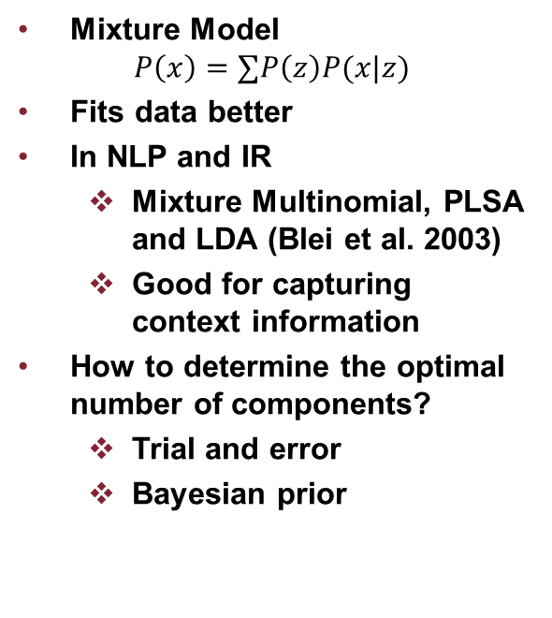
Mixture Model
Mixture Model
$$P\left(x\right)=∑P\left(z\right)P(x|z)$$
Fits data better
In NLP and IR
Mixture Multinomial, PLSA and LDA (Blei et al. 2003)
Good for capturing context information
How to determine the optimal number of components?
Trial and error
Bayesian prior
Figure 1: Bishop C. M., Pattern Recognition and Machine Learning, 2006
Notes:
To make HMM better with context information. Here we use the idea of mixture model. I will illustrate mixture model with this figure. It is possible to model the data with one Gaussian distribution. But with 3 Gaussian distribution, you can fit the data much better. Mixture model has a component indicator and the each component has its own distribution. It has been widely used in NLP and IR. There are models such as mixture multinomial, PLSA and LDA. However, using mixture model brings up a problem. How many components I should use to fit the data well without over-fitting. For a simple mixture model without regularization, the likelihood of the model will increase as the number of component increases. There are several approaches to address the problem. One way is to do by which I called trial and error. I use training data to learn a number of models, each using a different number of components. And then I test these models on the validation data and pick the one with the best performance. Another approach is use a Bayesian prior and the likelihood will no longer to be a monotonic function of component numbers. Then it is possible to identify the optimal numbers. In this study we use Dirichlet Process as the Bayesian prior.

Slide 5
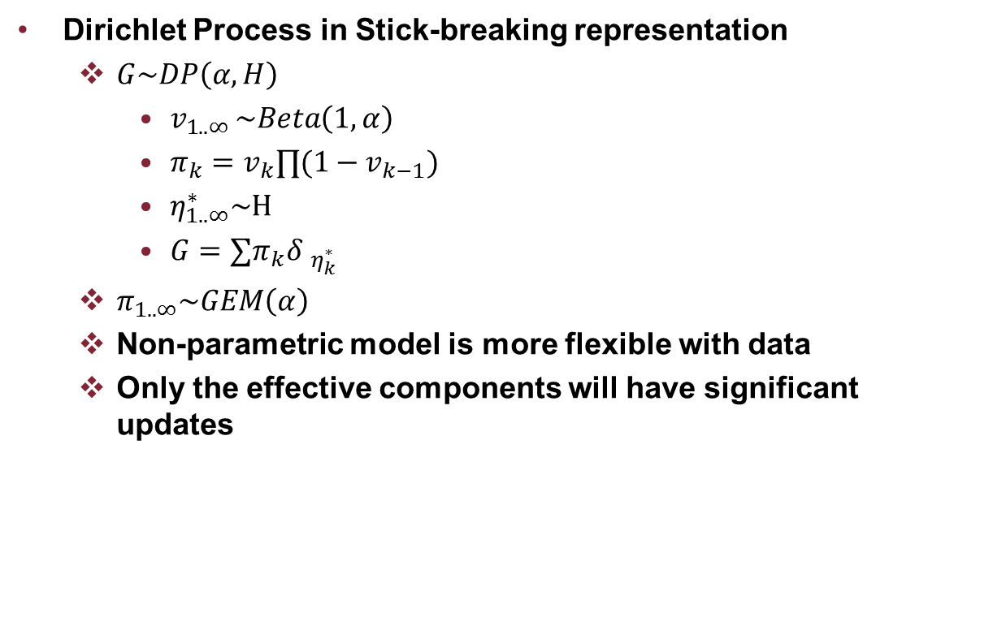
Dirichlet Process
Dirichlet Process in Stick-breaking representation
$G\sim DP\left(α, H\right)$
$v_{1..∞ }\sim Beta\left(1, α\right)$
$π_{k}=v_{k}∏(1−v_{k−1})$
$η_{1..∞}^{∗}\sim H$
$G=∑π_{k}{δ }_{η_{k}^{∗}}$
$π_{1..∞}\sim GEM\left(α\right)$
Non-parametric model is more flexible with data
Only the effective components will have significant updates
Notes:
Dirichlet Process is non-parametric distribution. Here we use DP in stick-breaking representation. There are other representation of DP but I found this representation is easier to understand. What does this Process produce? It gives a distribution. Then I can use the distribution generated from the process to generate data. It has two parameters a concentration parameter alpha and a base distribution H. For this process, first a beta distribution controlled by alpha produces a number of weights. It is easy to verify the sum of pi is 1. Next the base distribution H generates the corresponding number of atoms. Then lay weights on the atoms and give us a new distribution G. Also the weights by itself is also a distribution, is called GEM distribution. This non-parametric distribution is more flexible with data. The beauty of the non-parametric model is the model will determine how many components we need based on the data. When we compute the posterior, only the needed components will be updated significantly.

Slide 6

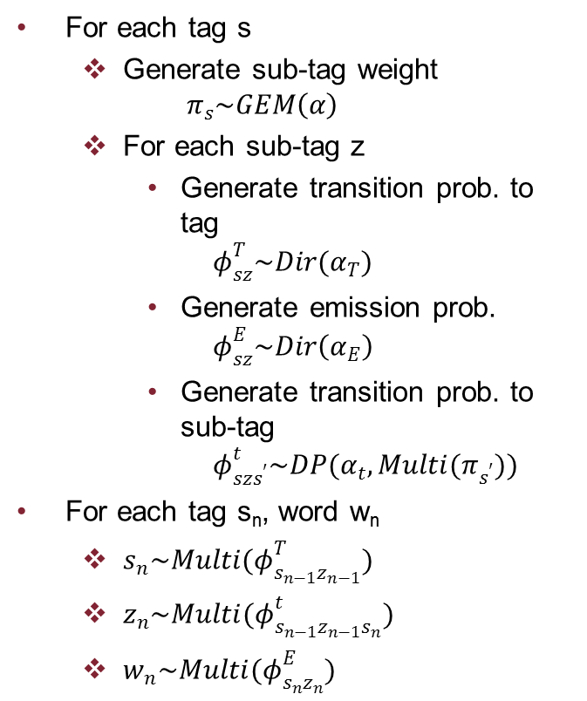



HMM-DP
For each tag s
Generate sub-tag weight
$$π_{s}\sim GEM\left(α\right)$$
For each sub-tag z
Generate transition prob. to tag
$$φ_{sz}^{T}\sim Dir(α_{T})$$
Generate emission prob.
$$φ_{sz}^{E}\sim Dir\left(α_{E}\right)$$
Generate transition prob. to sub-tag
$$φ_{szs^{′}}^{t}\sim DP(α_{t},{Multi(π}_{s^{′}}))$$
For each tag s_{n}, word w_{n}
$s_{n}\sim Multi(φ_{s_{n−1}z_{n−1}}^{T})$
$z_{n}\sim Multi(φ_{s_{n−1}z_{n−1}s_{n}}^{t})$
$w_{n}\sim Multi(φ_{s_{n}z_{n}}^{E})$
$$φ_{sz}^{T}$$
s₁
s₂
s₃
z₁
z₂
z₃
$$π_{s}$$
$$φ_{szs^{′}}^{t}$$
w₁
w₂
w₃
$$φ_{sz}^{E}$$

Slide 7
Out-of-dictionary words
4 categories of words: alphabet word, number, phone (template), numerical date (template)
Word Category | Feature function
Alphabet word | Word signature for capitalization, format, length(max 5), QO05a11 as AA11a
 | Is word in a list of names
 | Is word in a list of month, season, weekday, and abbreviation such as ‘m/w/f’
 | Is word in a list of countries, provinces/states and cities
Number | Number format, for example, 320.821.2954 as 111.111.1111
Date | Date format, for example, 2014-11-14 as 1111-11-11
Phone

Slide 8
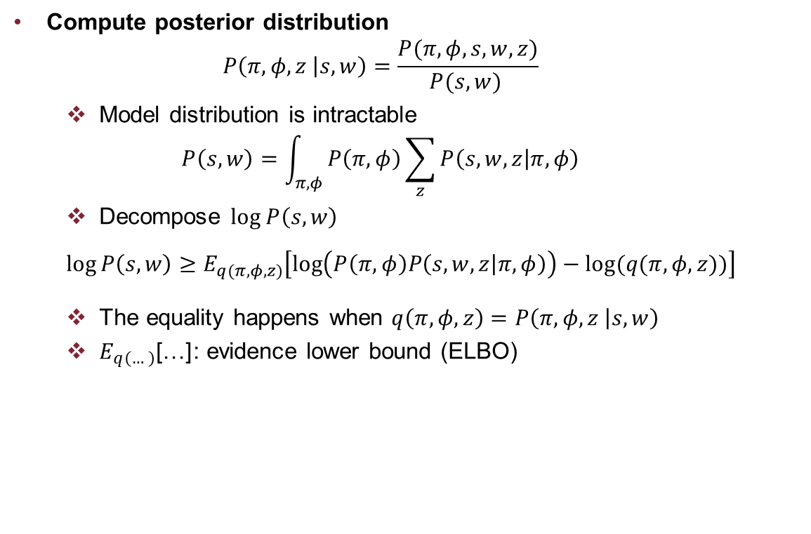
Learning-1
Compute posterior distribution
$$P\left(π,φ,z | s,w\right)=\frac{P(π,φ, s,w,z)}{P(s,w) }$$
Model distribution is intractable
$$P\left(s,w\right)=\int_{π,φ}{P\left(π,φ\right)\sum_{z}{P\left(s,w,z | π,φ\right)}}$$
Decompose $log P\left(s,w\right)$
$$\log{P\left(s,w\right)}≥E_{q(π, φ,z)}\left[\log\left(P\left(π,φ\right)P\left(s,w,z | π,φ\right)\right)−log⁡(q(π, φ,z))\right]$$
The equality happens when $q\left(π, φ,z\right)=P\left(π,φ,z | s,w\right)$
$E_{q\left(…\right)}\text{[…]}$: evidence lower bound (ELBO)

Slide 9
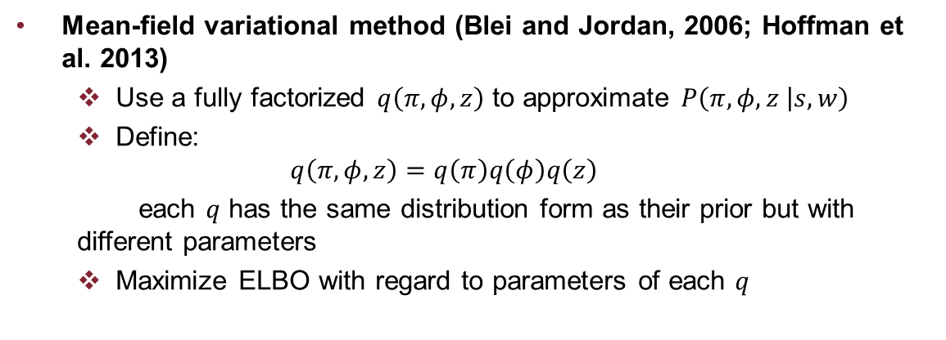
Learning-2
Mean-field variational method (Blei and Jordan, 2006; Hoffman et al. 2013)
Use a fully factorized $q\left(π, φ,z\right)$ to approximate $P\left(π,φ,z | s,w\right)$
Define:
$$q\left(π, φ,z\right)=q\left(π\right)q\left(φ\right)q\left(z\right)$$
each $q$ has the same distribution form as their prior but with different parameters
Maximize ELBO with regard to parameters of each $q$

Slide 10
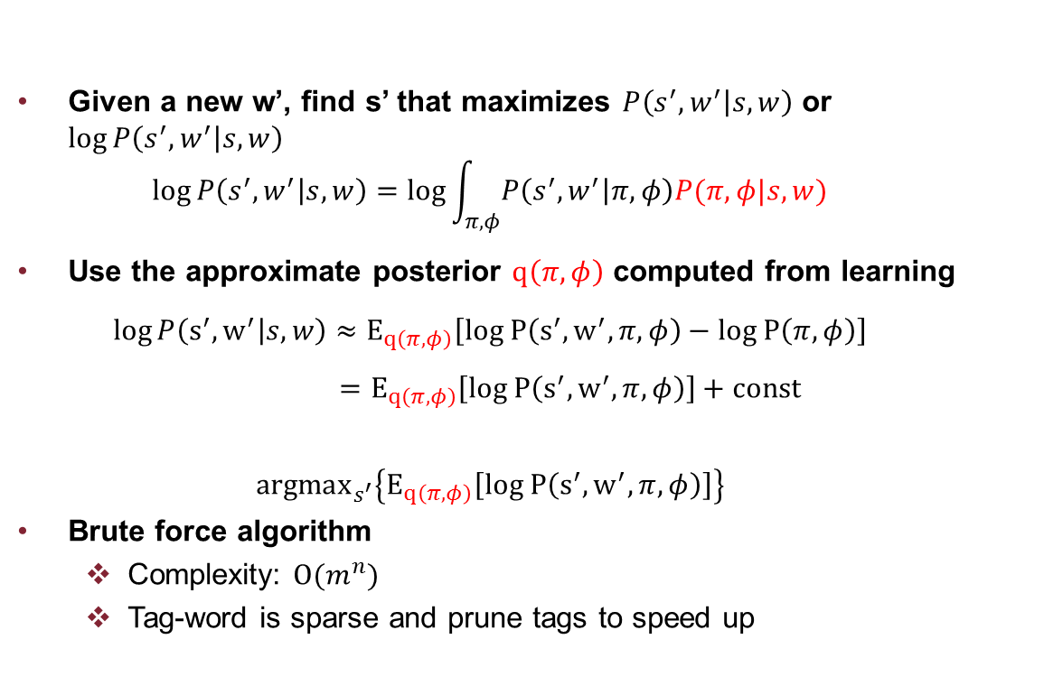
Prediction-1
Given a new w’, find s’ that maximizes $P\left(s^{′},w^{′} | s,w\right)$ or $\log{P\left(s^{′},w^{′} | s,w\right)}$
$$\log{P\left(s^{′},w^{′} | s,w\right)}=\log{\int_{π,φ}{P\left(s^{′},w^{′} | π, φ\right)P(π,φ|s,w)}}$$
Use the approximate posterior $q\left(π,φ\right)$ computed from learning
$$\log{P\left(s^{′},w^{′} | s,w\right)}≈E_{q\left(π,φ\right)}\left[log P\left(s^{′},w^{′}, π, φ\right)−log P\left(π,φ\right)\right]$$
$=E_{q\left(π,φ\right)}\left[log P\left(s^{′},w^{′}, π, φ\right)\right]+const$
$${argmax}_{s^{′}}\left\{E_{q\left(π,φ\right)}\left[log P\left(s^{′},w^{′}, π, φ\right)\right]\right\}$$
Brute force algorithm
Complexity: $O(m^{n})$
Tag-word is sparse and prune tags to speed up

Slide 11
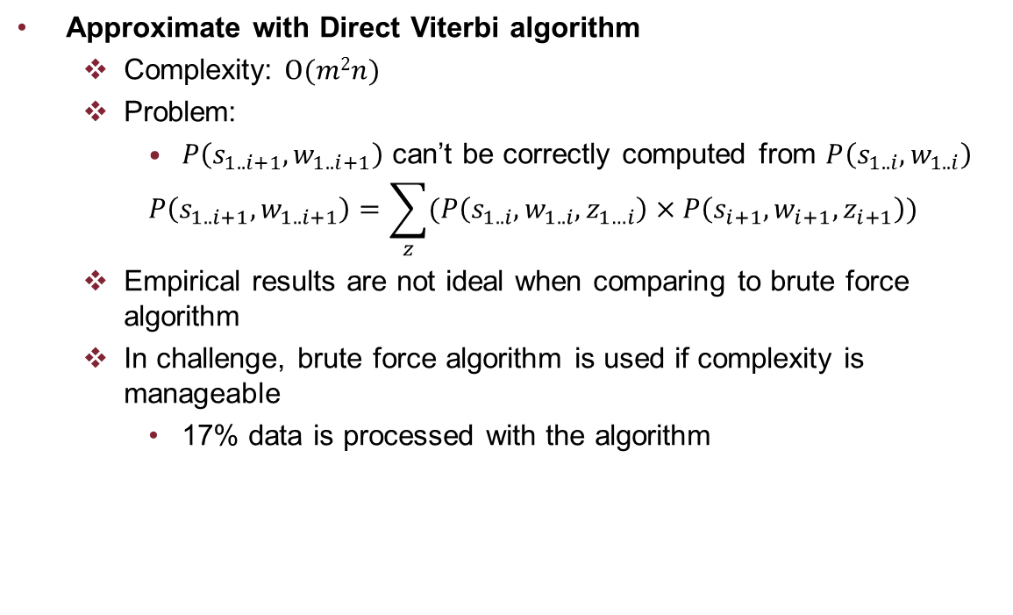
Prediction-2
Approximate with Direct Viterbi algorithm
Complexity: $O(m2n)$
Problem:
$P\left(s_{1..i+1},w_{1..i+1}\right)$ can’t be correctly computed from $P\left(s_{1..i},w_{1..i}\right)$
$$P\left(s_{1..i+1},w_{1..i+1}\right)=\sum_{z}{(P\left(s_{1..i},w_{1..i},z_{1…i}\right)×P\left(s_{i+1},w_{i+1},z_{i+1}\right))}$$
Empirical results are not ideal when comparing to brute force algorithm
In challenge, brute force algorithm is used if complexity is manageable
17% data is processed with the algorithm

Slide 12
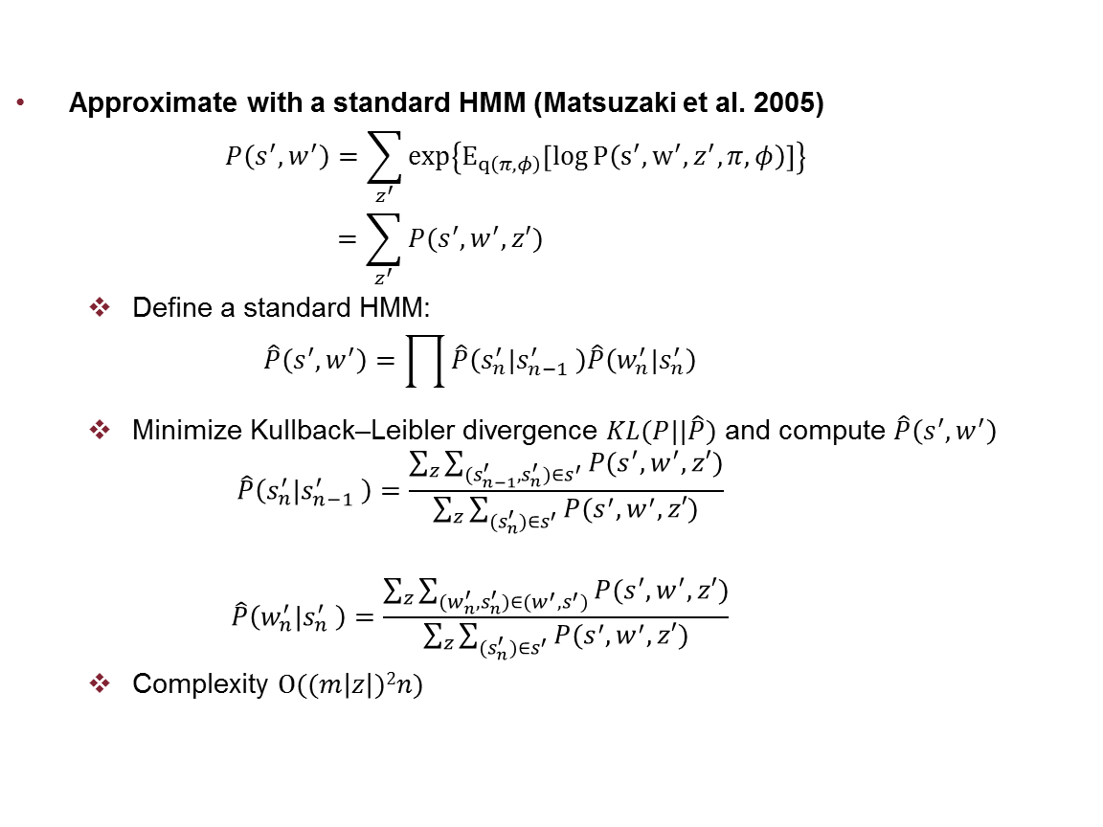
Prediction-3
Approximate with a standard HMM (Matsuzaki et al. 2005)
$$P\left(s^{′},w^{′}\right)=\sum_{z^{′}}{\exp\left\{E_{q\left(π,φ\right)}\left[\log{P\left(s^{′},w^{′}, z^{′},π, φ\right)}\right]\right\}} \\ =\sum_{z^{′}}{P(s^{′},w^{′},z′)}$$
Define a standard HMM:
$$\hat{P}\left(s^{′},w^{′}\right)=\prod{\hat{P}\left(s_{n}^{′}|s_{n−1}^{′} \right)\hat{P}\left(w_{n}^{′}|s_{n}^{′}\right)}$$
Minimize Kullback–Leibler divergence $KL(P||\hat{P})$ and compute $\hat{P}\left(s^{′},w^{′}\right)$
$$\hat{P}\left(s_{n}^{′}|s_{n−1}^{′} \right)=\frac{\sum_{z}{\sum_{(s_{n−1}^{′},s_{n}^{′})∈s^{′}}{P(s^{′},w^{′},z′)}}}{\sum_{z}{\sum_{(s_{n}^{′})∈s^{′}}{P(s^{′},w^{′},z′)}}}$$
$$\hat{P}\left(w_{n}^{′}|s_{n}^{′} \right)=\frac{\sum_{z}{\sum_{(w_{n}^{′},s_{n}^{′})∈{(w^{′},s}^{′})}{P(s^{′},w^{′},z′)}}}{\sum_{z}{\sum_{(s_{n}^{′})∈s^{′}}{P(s^{′},w^{′},z′)}}}$$
Complexity $O((m\left|z\right|)2n)$

Slide 13
Implementation
In challenge, HMM-DP is developed on PHI category not sub-category and hand crafted rules are used to further classifies category to sub-category
Category | Sub-Category | Rule
Name | Patient, Doctor, Username | IF the token consists of number, label it as USERNAME. For all occurrences of the token in the medical note, if there exists one occurrence that `Dr.’ or `M.D.’ are in the 2-token window of the token, label it as DOCTOR, otherwise as PATIENT
LOCATION | HOSPITAL, ORGANIZATION | If the token contains `hospital', `nursing', `center', `health' or the token is all upper case, label the token as HOSPITAL, otherwise as ORGANIZATION
 | ZIP, CITY, STATE, COUNTRY, STREET | If the token is all digits, label it as ZIP. If the token is in city list, label it as CITY. If the token is in STATE list, label it as STATE. If the token is in COUNTRY, label it as COUNTRY. Otherwise, label it as STREET
Contact | PHONE, EMAIL | If the token contains `@', label it as EMAIL, other- wise as PHONE
IDs | MEDICALRECORD, IDNUM | If the token first occurrence in the medical note is in the first 100 tokens, label the token as MEDICALRECORD, otherwise as IDNUM

Slide 14
Performance-1
 | Precision | Recall | F1
HMM for sub-category | 0.897 | 0.718 | 0.798
HMM-DP for challenge | 0.855 | 0.803 | 0.828
HMM-DP Improved | 0.951 | 0.871 | 0.909
HMM-DP Improved is developed on sub-category and use the new predication algorithm
HMM-DP is better at recall than HMM by better capturing context information
Dirichlet Process helps select the number of components in the mixture model
Mixture model better captures the long range context information by assigning to sub-tags

Slide 15









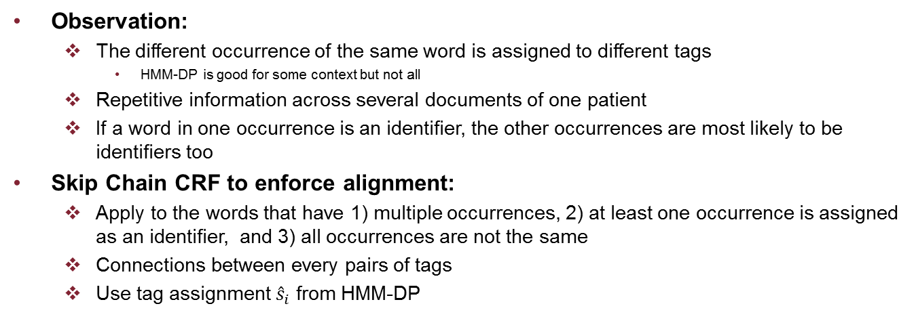












Alignment
Observation:
The different occurrence of the same word is assigned to different tags
HMM-DP is good for some context but not all
Repetitive information across several documents of one patient
If a word in one occurrence is an identifier, the other occurrences are most likely to be identifiers too
Skip Chain CRF to enforce alignment:
Apply to the words that have 1) multiple occurrences, 2) at least one occurrence is assigned as an identifier, and 3) all occurrences are not the same
Connections between every pairs of tags
Use tag assignment ${\hat{s}}_{i}$ from HMM-DP
$$S_{i}$$
$$S_{j}$$
$$S_{k}$$
$${\hat{s}}_{i−2}$$
$$⋯$$
$${\hat{s}}_{i}$$
$$⋯$$
$${\hat{s}}_{i+2}$$
$${\hat{s}}_{j−2}$$
$$⋯$$
$${\hat{s}}_{j}$$
$$⋯$$
$${\hat{s}}_{j+2}$$
$${\hat{s}}_{k−2}$$
$$⋯$$
$${\hat{s}}_{k}$$
$$⋯$$
$${\hat{s}}_{k+2}$$
$$w_{i−2}$$
$$⋯$$
$$w_{i}$$
$$⋯$$
$$w_{i+2}$$
$$w_{j−2}$$
$$⋯$$
$$w_{j}$$
$$⋯$$
$$w_{j+2}$$
$$w_{k−2}$$
$$⋯$$
$$w_{k}$$
$$⋯$$
$$w_{k+2}$$

Slide 16
Performance-2
 | Precision | Recall | F1
HMM for sub-category | 0.897 | 0.718 | 0.798
HMM-DP for challenge | 0.855 | 0.803 | 0.828
HMM-DP Improved | 0.951 | 0.871 | 0.909
HMM-DP Improved + Alignment | 0.959 | 0.902 | 0.929
Alignment helps both precision and recall and improves recall much significantly

Slide 17
Conclusion
A new model better at capturing context information
A variational learning algorithm
Brute-force and efficient prediction algorithms
Alignment to further improve performance

Slide 18
Reference
C. Manning and H. Schtze, Foundations of Statistical Natural Language Processing,. Cambridge, MA: MIT Press, May 1999.
J. R. Finkel, T. Grenager, and C. Manning, “Incorporating non-local information into information extraction systems by Gibbs sampling,” in Proceedings of the ACL 2005, pp. 363–370, 2005.
D. M. Blei, A. Ng, and M. I. Jordan, “Latent Dirichlet allocation,” Journal of Machine Learning Research, vol. 3, pp. 993–1022, 2003.
O. Uzuner, Y. Luo, and P. Szolovits, “Evaluating the state-of-the-art in automatic de-identification,” Journal of the American Medical Informatics Association, vol. 14, pp. 550–563, 2007.
L. Deleger, K. Molnar, G. Savova, F. Xia, T. Lingren, Q. Li, K. Marsolo, A. Jegga, M. Kaiser, L. Stoutenborough, and I. Solti, “Large-scale evaluation of automated clinical note de-identification and its impact on information extraction,” Journal of the American Medical Informatics Association, vol. 20, pp. 84–94, 2013.
Z. Huang, M. Harper, and W. Wang, “Mandarin part-of-speech tagging and discriminative reranking,” in Proc. of the EMNLP 2007, pp. 1093–1102, 2007.
Z. Huang, V. Eidelman, and M. Harper, “Improving a simple bigram hmm part-of-speech tagger by latent annotation and self-training,” in Proc. of the NAACL 2009, pp. 213–216, 2009.
C. M. Bishop, Pattern Recognition and Machine Learning. Springer, 2006.
T. L. Griffiths and M. Steyvers, “Finding scientific topics,” Proceedings of the National Academy of Sciences, vol. 101, no. suppl 1, pp. 5228–5235, 2004.
D. Koller and N. Friedman, Probabilistic Graphical Models: Principles and Techniques. Cambridge, MA: MIT Press, July 2009.
D. M. Blei and M. I. Jordan, “Variational inference for Dirichlet process mixtures,” Bayesian Analysis, vol. 1, no. 1, pp. 121–144, 2006.
M. D. Hoffman, D. M. Blei, C. Wang, and J. Paisley, “Stochastic variational inference,” Journal of Machine Learning Research, vol. 14, no. 1, 2013.
T. Matsuzaki, Y. Miyao, and J. Tsujii, “Probabilistic cfg with latent annotations,” in Proc. of the ACL 2005, pp. 75–82, 2005.
A. Stubbs, C. Kotfila, H. Xu, and O. Uzuner, “Practical applications for NLP in clinical research: the 2014 i2b2/UTHealth shared tasks,” Journal of Biomedical Informatics, 2014.

